Slide 1
K-12 Engineering:
Integrated Strategies That Work
Elizabeth Parry
Chair, ASEE K-12 and Precollege Division and NCSU College of Engineering
Notes:
Current Projects
Members represent K-12 engineering on foundation boards, STEM advocacy groups and NAE studies
Leadership regularly interacts with EDC, CMC K-12 SIG, HQ and other STEM constituency groups (NSTA, ITEEA, NCTM, NAEP, NAE, etc)
Chair and members working on Next Generation Science Framework and Standards review and implementation
Members contributing to research base on effective K-12 engineering education and publishing results
Members on state K-12 engineering standards writing teams in several states

Slide 2
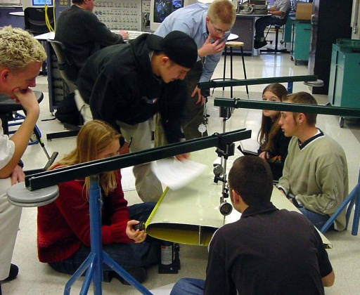
ASEE K-12 and
Precollege Division
Formed in 2005
742 members (12th largest in ASEE)
90% of members are university faculty, instructors or staff
Majority (80%+) are discipline engineers
42% women (vs. 22% ASEE overall)
In 2012, division received 176 abstracts and will present 100 papers in sessions scheduled in every time slot at the annual conference in June
20% of Journal of Engineering Education articles published in last 4 years involved work in K-12
Notes:
The division has steadily grown it’s membership since becoming an official ASEE division in 2005, with current membership just under 800 .
64% of members are academic professionals
5% are academic institutional contacts
Regarding rank at colleges and universities,
37% are full or associate professors
18% are assistant professors or instructors
35% are other academic professionals
Remainder are non academic members (university students , K-12 teachers or industry)
Compared to ASEE’s total percentage of women members, (22.3%), K-12 division members are 41.2% women. Eleven of the 12 members of the current executive board are women. All members of the executive board, with the exception of our K-12 representative, are discipline engineers from universities.
The division focuses on research based technical paper presentations and has received between 170-220 abstracts for the past four years. Each is blind reviewed at both the abstract and the paper stage, resulting consistently in about 130 papers presented at each annual conference. K-12 and Precollege offers at least one session in every available session slot at the annual conference.

Slide 3
K-12 and Precollege Division
Strategic Areas
Goal is to be the center of competency for K-12 engineering research and practice
Strategy is to form collaborations of key stakeholder groups in K-20 engineering and STEM education
Focus on development of research based professional development and curricula for K-12 students and teachers
Fully participate in policy issues impacting K-12: funding priorities, standards and assessments
Utilize extensive research, university and industry talent base to ensure ASEE is “at the table” on key national STEM issues
Notes:
The K-12 and Precollege Division strives to provide a focus for development of innovative K-12 engineering education curricula and delivery approaches and a forum for the presentation and sharing of K-12 engineering educational initiatives and methods; create a vital community engaged in K-12 engineering initiatives; encourage the professional development of teachers in K-12 engineering education methodologies; increase awareness and participation of university faculty and industrial educators/partners in K-12 engineering initiatives; promote engineering as the context to integrate science and mathematics with all subjects in the K-12 setting; encourage the participation of K-12 educators in the creation and delivery of K-12 engineering content; and, synthesize and broadly disseminate lessons learned.
The current executive board has representation from North Carolina State University (2); Vanderbilt University; Duke University; University of Colorado-Boulder; Oklahoma State University; University of Virginia ; Worchester Polytechnic University; University of Minnesota; Purdue University; University of Kentucky and the Mobile Area Education Foundation.
Seven K-12 and Precollege members are ASEE Fellows.
K-12 members are heavily involved in engineering education research and practice in K-12 and undergraduate education.

Slide 4
Selected Current Division Work Efforts
Executive board convening invited national meetings on K-12 engineering:
May 2010: Defining Engineering in Elementary Grades (Raleigh, NC)
June 2010: Defining the Top Research Questions in K-12 engineering (Louisville, KY)
June 2011: Identifying Barriers and Opportunities in K-12 Engineering (Vancouver, BC)
June 2012: Defining Professional Development Standards for K-12 Engineering (meeting collaboration with UTEACH, San Antonio, TX)
July 2012: Colloquium on P-12 Engineering Education (collaboration with STEM Center, Minneapolis, MN)
Division leadership collaborating with Purdue INSPIRE on J-PEER journal of engineering education research
Developing collaboration with NSTA on science and engineering standards

Slide 5
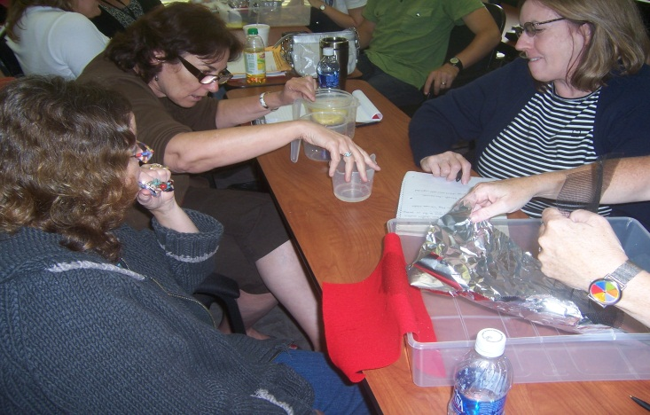
K-12 Engineering: Division View
Engineering in K-12 is focused on the process of engineering design (“engineering the verb”)
Foundational ideas, based on ABET Criteria 3 on Student Outcomes, are promoted, including:
Design under constraints
Collaboration
Communication
Ethics
Failure/Improvement
The primary goal in K-12 is to introduce engineering design to all students to create a better prepared, more informed, more diverse and larger pool of students who are able to choose engineering and who are technological and engineering literate citizens
Notes:
K-12 and Precollege Members participate in:
-Common Core Mathematics standard implementation and integration
-Development and implementation of the Next Generation Science Standards, which are due to be released this spring and include engineering design as a fourth component, at the same level of importance as Physical, Life and Earth Science.
-writing and implementation of Engineering Standards at the state level. Multiple states have included engineering principles as a part of science standards; some, including Massachusetts and North Carolina, have independent K-12 engineering standards.
-National efforts such as Change the Equation and NAE and NRC studies
-Development of the National Assessment of Educational Progress (NAEP) Engineering and Technological Literacy Standards and Assessment to be implemented in 2014
-National study groups on STEM issues
-Convening national meetings on K-12 engineering education
-significantly contributing to the body of research knowledge around engineering education in K-20

Slide 6
The Landscape: Higher Education
Highest % of Engineering Bachelors Degrees Conferred:
  7.8% in 1985; Recent years : 4%
Majority of engineers educated at public universities (~65%); funding is down, tuition is up
College of Engineering retention rates (Average, 2007): 56%
  Attributed not to ability or performance, but rather to dissatisfaction with first (and or second) year of courses (little to no hands on)
Diversity remains an issue:
  Women are now nearly 20% of engineering graduates. However, only 11% of professional engineers are women (National Science Foundation, 2011 ), a statistic that has been stable for nearly 20 years.
  African American engineers are 6% of the engineering workforce (12% of the population) (US News and World Report, Oct. 2011)
  Hispanic/Latino engineers 6.2% of workforce (16% of population)

Slide 7
The Landscape: K-12 Education
NCLB/ESEA: uncertainty reigns; test centric environment
Common Core implementation of Math and ELA
Next Gen Science : inclusion in accountability model?
Funding: Per Pupil Spending; Instructional Supplies, Professional Development
K-12 Preparation and Professional Development
  Little change in teacher prep for many years
  Science Methods vs. Content
  Little, if any, Engineering
  Technology is Instructional vs. Human Made Design
  Mathematics, and all subjects, are in silos

Slide 8
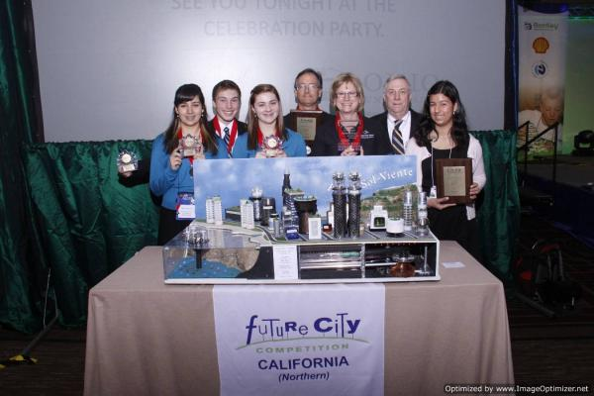
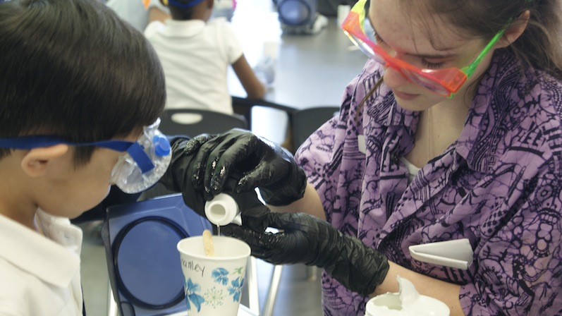
What is the value of OUTREACH?
Outreach: single visits to promote engineering
Single visit: classroom visits (presentations and activities), mentorships in FIRST, Future City, clubs, etc. develops positive impression of engineering
Creates goodwill with community
Supports STEM career knowledge and development in K-12 students
Increases K-12 and community knowledge of university programs and of engineering profession
Non monetary contributions extremely valued by K-12 but they may need direction
Notes:
Outreach is the traditional term typically referring to any involvement in K-12. In the last eight years or so, “outreach” has come to mean the single visit interactions where university faculty and students go to K-12 schools and classrooms to give presentations, do activities, speak during engineer’s week, mentor students for national competitions such as Lego Robotics, FIRST competitions, Future City, etc., and work with after school clubs.
Sustained engagement involvement typically has a research focus and is funded by NSF, DOD, NIH, Dept of Ed, or Foundations who are seeking sustained effort that will inform future investments. Research conducted is both qualitative and quantitative, measuring attitudes, aptitudes, interests, standardized test scores, and persistence. Typically, all students are involved in these efforts although a focus on students from underrepresented groups in STEM (women, minorities' high poverty, etc) are specifically addressed in implementation. Research from division members and others shows positive outcomes and impacts on both K-12 and undergraduate and graduate students in both short and long term measures.

Slide 9
What is the value of SUSTAINED ENGAGEMENT?
Sustained Engagement: longer partnerships to conduct research and change practice
Attracts a larger and more diverse cross section of university student and industry participants
Qualifies for significant research funding for university (NSF, NIH, DOD, Department of Ed, Industry Foundations etc)
Promotes collaborations
Addresses national priority to increase STEM pipeline
Builds research base on effective teaching and learning best practices K-20
Attracts and increases industry and alumni support
Often sustained by graduates when they start career

Slide 10
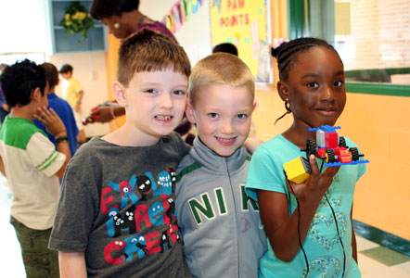
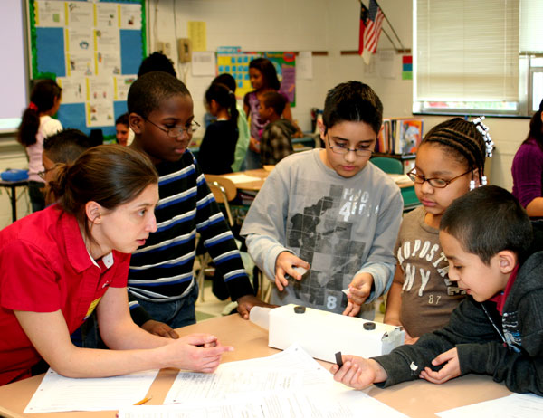
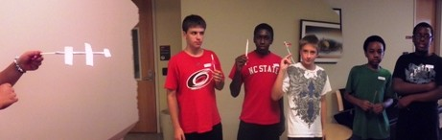
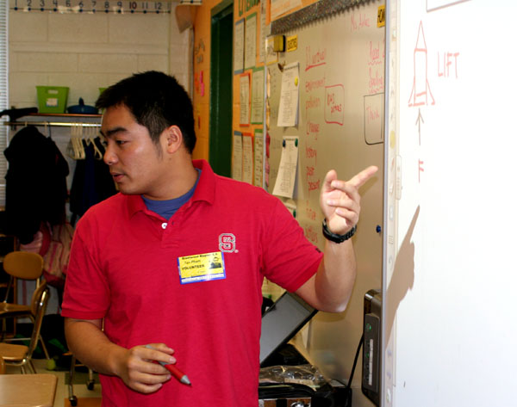
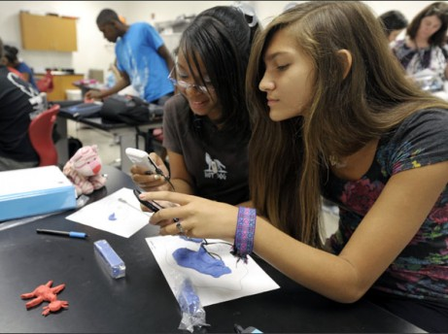
Integrated
STEM in
Action

Slide 11
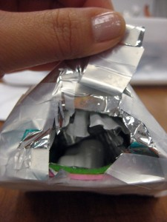
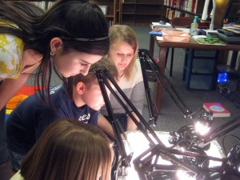
Rural SW Virginia
A three year after-school program that focuses on key science concepts and engineering design
1.3 M Funded by NSF (ITEST)
Collaborative project between Virginia Tech, Univ. of Kentucky, and Temple University
Save the Penguins, Sea Birds, Bats, and Fish
Approximately 20 middle school youth per site
Assessing motivation, identification with engineering, science, and technologies, and also science conceptual knowledge.
Integrating networking tools such as Edmodo for discussion between sites.
PI team: Michael Evans, Chris Schnittka, Brett Jones, Carol Brandt
http://studiostem.org/wordpress/?page_id=123
Notes:
In three sites in rural south west Virginia, we have implemented engineering design-based curriculum with after-school youth in a studio setting. The curricula focus on energy sustainability, physical science concepts, and an environmental concept concerning an animal. Youth just completed Save the Penguins. In the fall they will do Save the Sea Birds, followed by Save the Bats. Click on the logo to see our Studio STEM website. Click on the video link to see a short video of the youth from last month. We are using the MUSIC model to understand how informal settings can impact youth’s identification with engineering, science, and technologies. (Osborne & Jones, 2011) .
Youth begin to identify with a domain when they believe that they are eMpowered, the domain is Useful to their goals , they believe they will Succeed in it , they are Interested in it , and they believe they are Cared for. We are also assessing science knowledge.

Slide 12
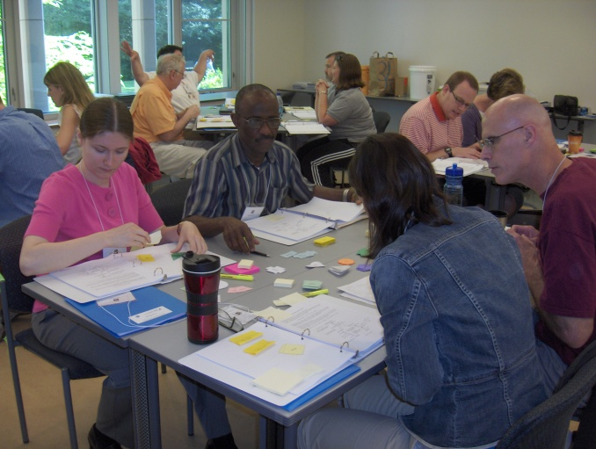
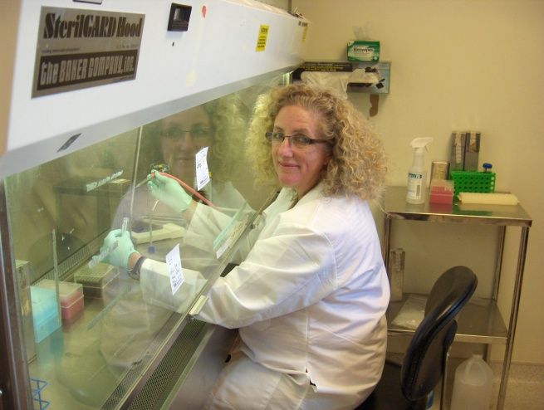
Vanderbilt University’s Research Experiences for Teachers (RET)
Funded by NSF ($1M+ over 9 years)
87 unique teachers and their students served
87 curriculum units created
  All available to any teacher
  Many of these on teachengineering.org
Peer-reviewed manuscripts
  Defining effective professional development in engineering
  Creating a Nature of Engineering instrument to measure growth in understanding of what engineering is

Slide 13
Center for STEM Education for Girls
Nashville, TN
Funded by the Edward E. Ford Foundation and matching grants ($500K)
Hosting the STEM Think Tank and Conference July 18-20, 2012
  250+ attendees expected
  60 concurrent sessions scheduled
  Serves K12 administrators, teachers, university outreach leaders and STEM program leaders, members of industry and informal educators
  Provides a means for communication across these communities
Research questions include
  What are the best practices in girls’ STEM education? Identify holes in literature for research
  What is the role of online STEM education for girls?

Slide 14
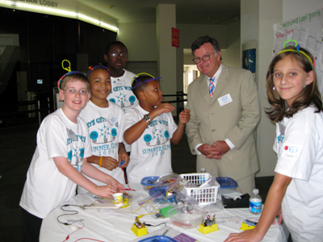
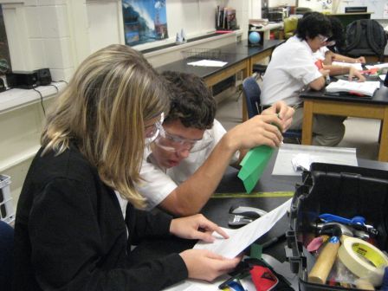
Engaging Youth through Engineering (EYE) Mobile, AL
Workforce and economic development initiative
Collaboration between Mobile Area Education Foundation, J. L. Bedsole Foundation, the Mobile County Public School System, the Mobile Area Chamber of Commerce, and the University of South Alabama
K-12 students and teachers work with industry and university engineers and researchers as well as undergraduate engineering students
Expansion in process to all grades K-12
Notes:
This partnership was initiated by the business community to address widespread issues in student achievement and engagement in southern Alabama. The project director is an engineering faculty member from the University of South Alabama. The initial project was intended to be middle school only; however, results to date have been so encouraging they are expanding into K-12. The model will be replicable for use in other areas.

Slide 15
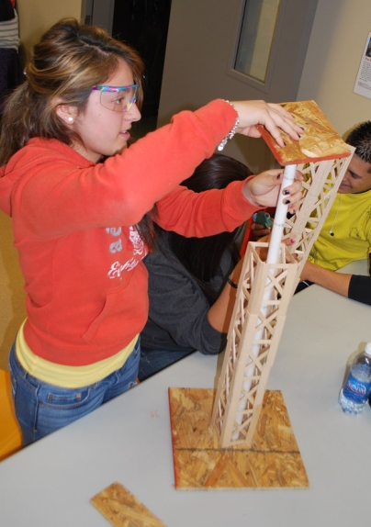
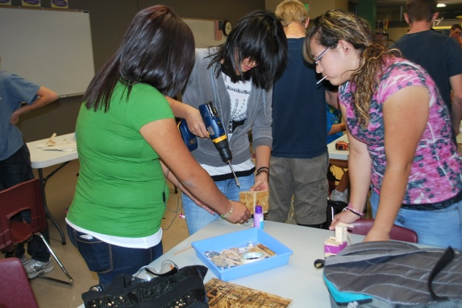
University of Colorado Boulder and
Skyline High School, Longmont
Creation of a 4-year high school STEM Academy,
coupled with early exposure in 6 feeder elementary
and 2 middle feeder schools
Students engage in hands-on engineering design
in every course, every year
Research on UC-B –Skyline High School partnership
demonstrates
  Increased enrollment into Skyline High School from
  schools outside of feeder schools
  Increased academic attendance and decreased suspensions
  Increased knowledge gain, engineering identity, and self
  efficacy (students’ self-reported)
  Preliminary indication of more students enrolling into
  engineering colleges
  Initial partnership funded through NSF GK-12 program
Notes:
To help reduce the high number of students, particularly white students, who would leave the school (as predicted by district officials), open enroll into a different high school, or drop out of high school completely, the Skyline High School STEM Academy program was created in 2009, in partnership with the long-established K-12 TEAMS Program at the University of Colorado Boulder. Skyline High School is a diverse school with 1,230 students across grades 9-12. 45% of the students are from economically disadvantaged families (free and reduced lunch eligible), compared to a high school average in the district of 20% and state of 40%. The combined Skyline High School and CU-Boulder K-12 leadership team has developed a comprehensive education plan for the STEM Academy, with the overarching goal of students pursuing post-secondary STEM degrees. In order to receive a STEM Certificate upon graduation, students are required to take 28 total high school credits (minimum district graduation requirement is 24.5 credits) and follow a challenging education plan during all four years that includes hands-on engineering design courses every year, modified from existing design courses at CU Boulder. As students move through the sequence of courses, they are engaged in increasingly complex hands-on design projects that peer into a variety of engineering disciplines, making engineering a part of their every day experience.
Skyline High School’s six feeder elementary and two middle schools have similar demographic patterns and are a key component in the recruitment and retention of underrepresented populations to the Academy. Thus, the University TEAMS partnership program has been introduced into all eight feeder school’s curriculum, developing shared learning goals between the nine schools.
Some references on this partnership include:
Zarske, M.S., Ringer, H.L., Yowell, J.L., Sullivan, J.F., Quinonez, P.A. (2012) The Skyline TEAMS Model: A Longitudinal Look at the Impacts of K-12 Engineering on Perception, Preparation and Persistence. Advances in Engineering Education. Summer 2012 (forthcoming).
Schnittka, C., Parry, E.A., Day, L.D., Macalalag, A.Z., Padilla, A., Zarske M.S., Quinonez, P.A. (2012) Best Practices in University Partnerships. In: ASEE Annual Conference Proceedings. San Antonio, TX; 2012 (forthcoming).
Zarske, M.S., Yowell, J.L., Sullivan, J.F., Bielefeldt, A.R., Knight, D.W., O’Hair, M.T. (2012) K-12 Engineering for Service: Do project-based service-learning design experiences impact attitudes in high school engineering students? In: ASEE Annual Conference Proceedings. San Antonio, TX; 2012 (forthcoming).

Slide 16
Integration through engineering in North Carolina
Begin integration through correlation of engineering units through science curricular goals
In elementary (K-5), use Engineering is Elementary and small engineering projects tied to literacy themes
In middle school and high school, use the Grand Challenges for Engineering as the integrating focus
Implement STEM notebooks (various forms depending on level)
Integrated instructional periods encompassing multiple subjects
Professional development: Initial and ongoing
University and industry collaborations
Research efficacy in terms of achievement and attitudes

Slide 17
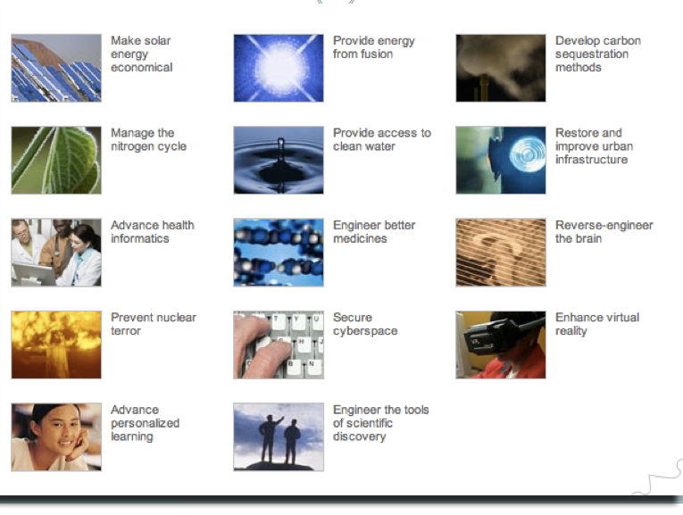
The Grand Challenges for Engineering

Slide 18
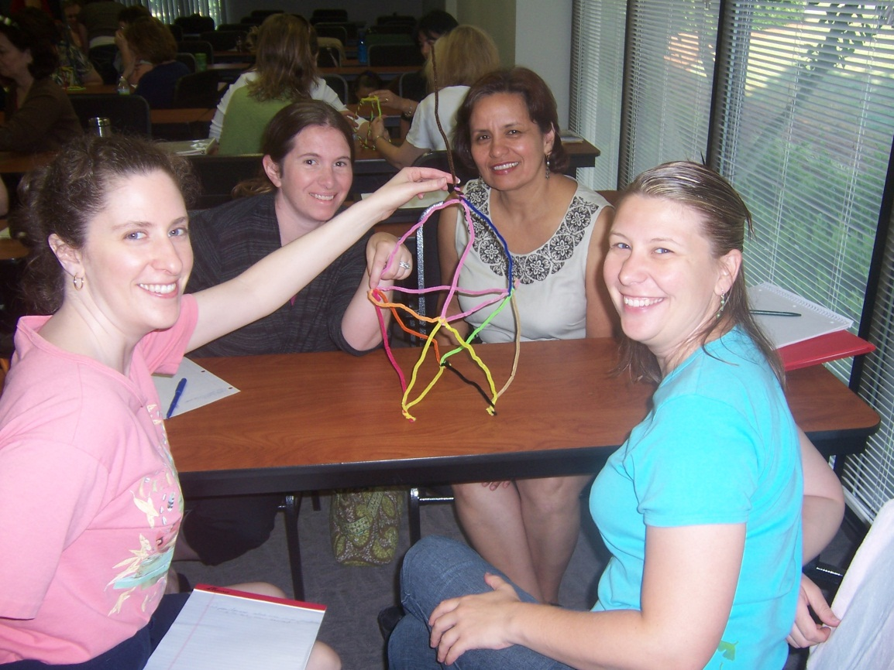
Professional Development Model
The Plan
Initial Professional Development of 3-5 days
Monthly or Quarterly Coaching with whole group, PLCs and/or grade levels
Liaison with STEM Coordinator

Slide 19
Professional Development:
The Program
PBL/Inquiry/Design
Science, Engineering, Technology
Integration Across Curriculum
Teaching and Assessing Creativity
STEM Notebooks
Creating Effective and Productive Teams
Content: Science, Engineering
The Engineering Design Process
Model, Model, Model

Slide 20

Wake-NC State Early
College High School
Located on NC State’c campus
Integrated STEM approach
Curriculum developed by professors and teachers in partnership
Based on NAE Grand Challenges for Engineering
Five class periods, ninth grade: integrated math, language arts, geography/social studies, integrated earth science/engineering design (2)
Focus on energy and sustainability challenges in first year; challenges selected using science curriculum as basis
Integrated math and geography selected to match the grand challenges
Students begin college classes in second year; professors and engineering students work in classrooms regularly
Summer bridge program for high school students held in conjunction with college bridge program

Slide 21

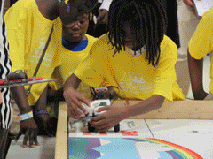
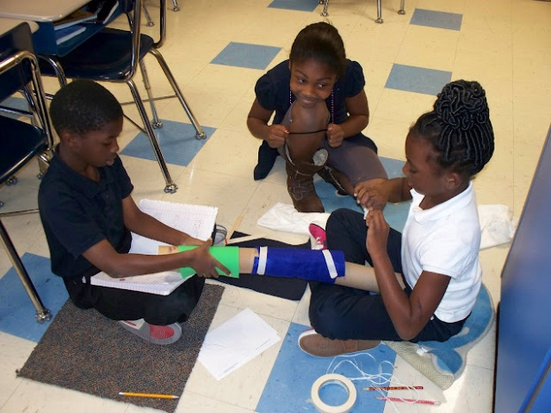
Wilmington, NC
In fifth year of using engineering as the integrator of all core subjects
Students are 99% African American and >90% high poverty
Long term NCSU partnership supported through research grants and as a Collaboration between College of Engineering and College of Education
Industry engineers support teachers and students
Overall student proficiency (Math, Language arts and Science) has increased from 19% to 69%
Model has been implemented in 3+ other NC schools and in six additional states
District is currently implementing engineering based middle and high schools
Notes:
The university involvement in this effort was one staff person about 20 days per year the first two years, and about 4 days a year since then. The district provided some financial support and the remainder covered through university grants. The research focus as been on student attitudes, teacher attitudes and change of practice, student persistence and study of how deeply the student adopts the engineering design process as a method of problem solving in general (a factor in the persistence study).
Teacher turnover at this school has gone from >20% per year to 3-4% since this implementation. The partnership is being recognized this year as one of three winners of the Best Practices in Partnership between Universities and K-12 at the annual conference in San Antonio. University and K-12 personnel will co-present the project’s overview.
The model is being replicated at five other NC schools and is used as a basis for schools in other states.

Slide 22
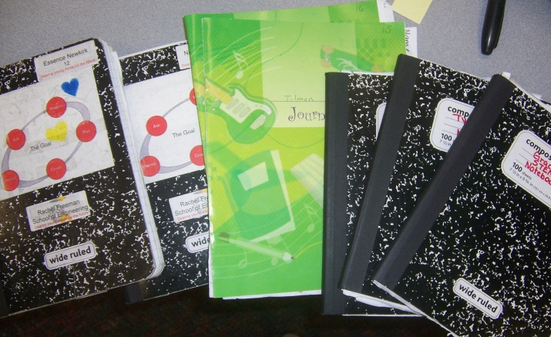
K-5 Foundational Skills Development
Overall focus on teaching and emphasizing:
The engineering design process
Working effectively in teams
STEM notebooks
Emphasize Engineering Habits of Mind:
Systems thinking
optimism
creativity
collaboration
communication
ethical considerations
Familiarize students and teachers with the Grand Challenges of Engineering

Slide 23
What can engineers do in the short term?
Join ASEE K-12 and Precollege Division and promote the Division to colleagues
Support (through funding and collaboration) outreach efforts at universities and companies
Recognize and promote the involvement of K-12 engineering educators in STEM efforts
Communicate to universities about current issues in undergraduate and graduate engineering programs (i.e. retention rates; preparedness; skills development; industry needs; etc)

Slide 24
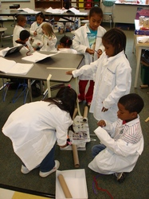
What can engineers do in the long term?
Advocate/collaborate/fund research projects to provide date driven base for effective practice and implementation
Advocate within your organizations to direct funding to K-20 engineering education issues specifically
Help increase awareness of K-12 STEM efforts to foundations, companies, organizations
Establish partnerships between organization and universities involved in K-12 STEM research and implementation.
Recognize the value of the engineering process in this realm: re-inventing the wheel is not good engineering!

Slide 25
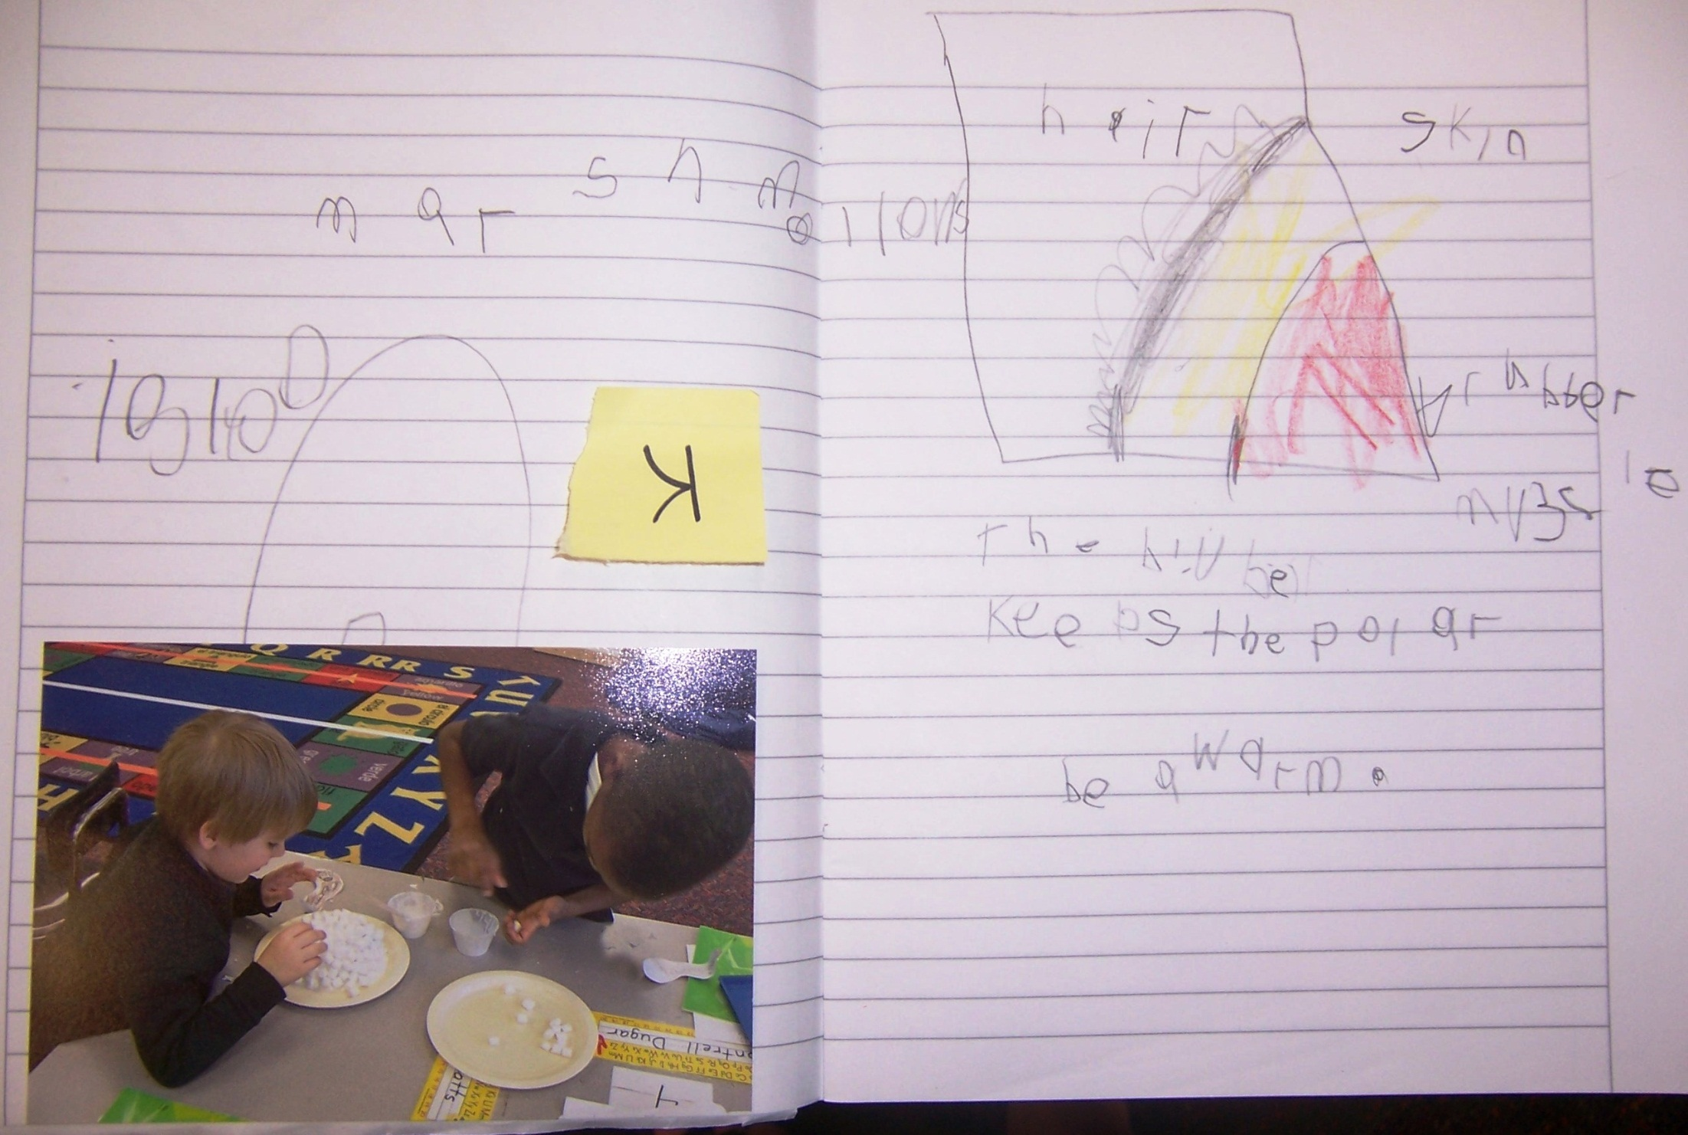
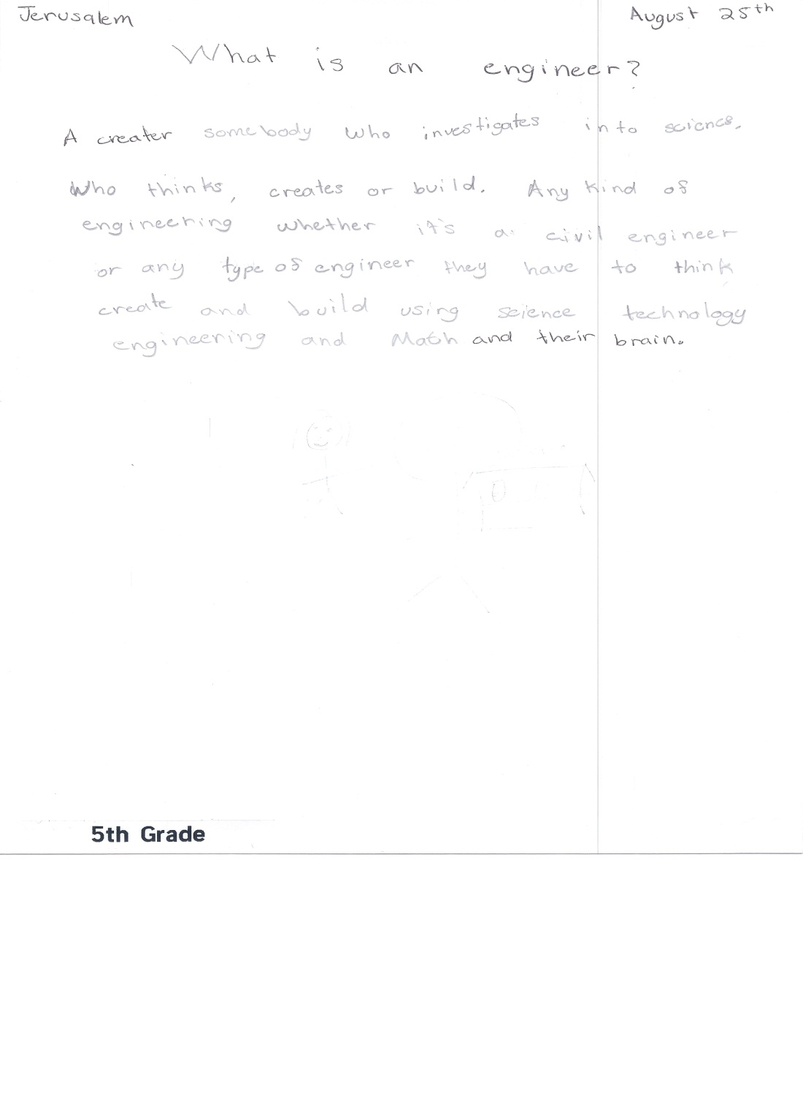
Kindergarten Designing and building igloos

Slide 26
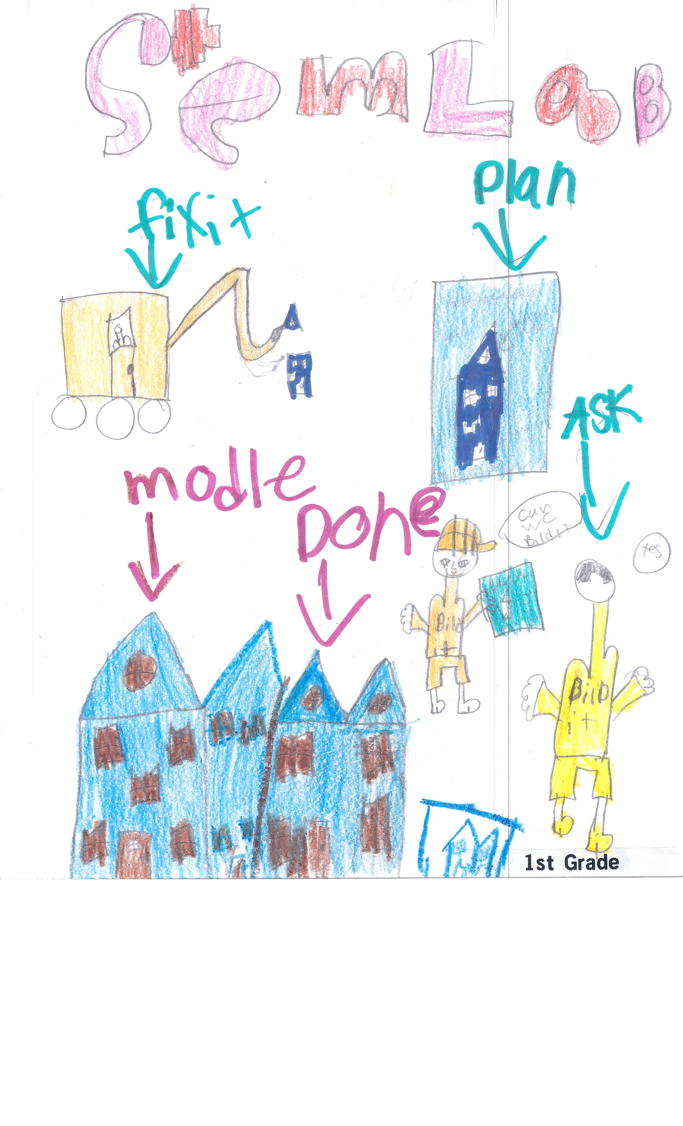

Slide 27
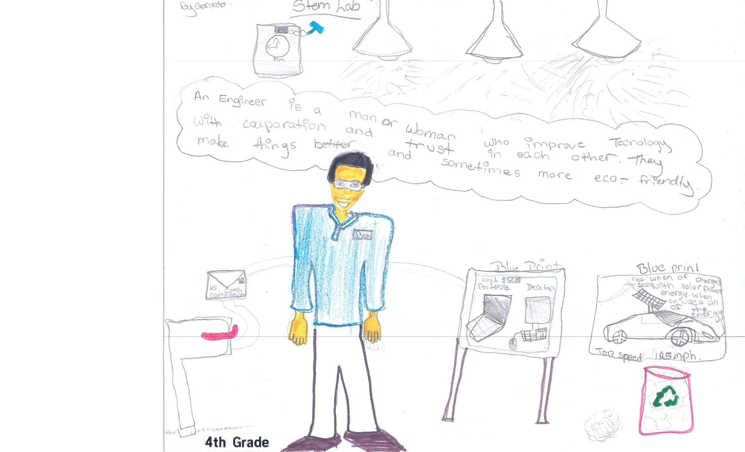

Slide 28
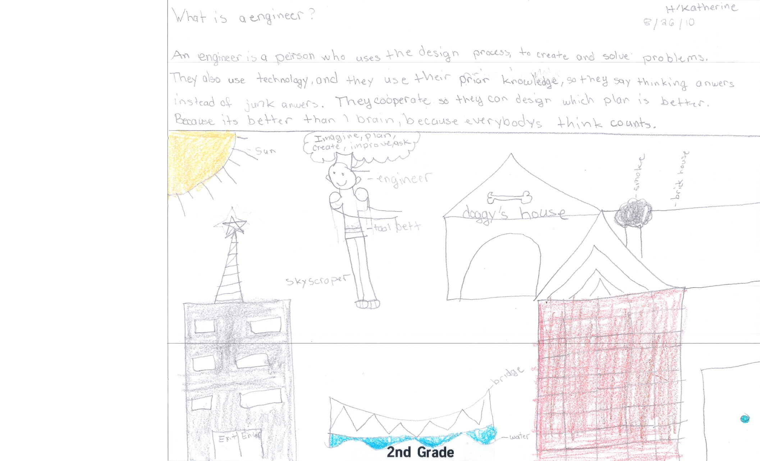
Wisdom from a
Second
Grader

Slide 29

To solve problems creatively.
Because engineers are essential to our health, safety and happiness.
To help shape the future.
To make a world of difference.
Because dreams need doing.
Just a few reasons people choose engineering.
Liz Parry eaparry@ncsu.edu
919-413-7313

